Slide 1

MALAVIYA NATIONAL INSTITUTE
OF TECHNOLOGY
EASE OF DOING BUSINESS

Slide 2
EASE OF DOING BUSINESS INDEX
The ease of doing business index is an index formulated by the World Bank Group which indicates the ease of doing business in a country.
Empirical research funded by the World Bank to justify their work show that the effect of improving these regulations on economic growth is strong.
The index is based on the study of laws and regulations, with the input and verification by more than 13,800 government officials, lawyers, business consultants, accountants and other professionals in 190 economies who routinely advise on or administer legal and regulatory requirements.

Slide 3
Higher rankings (a low numerical value) indicate better,
usually simpler, regulations for businesses and stronger
protections of property rights.
Current rank of India in ease of doing business is 77 which is
23 positions higher than previous year
In India , these ranking are based on business environment in
Delhi and Mumbai
The ease of doing business rankings are based on a country’s
performance on 10 parameters such as enforcing contracts
and starting a business etc..
PM Modi said that ease of doing business is to improve ease of living.

Slide 4
WHY IT’S IMPORTANT ?
Access to economic opportunities , international investors base their
investment decisions on a wide variety of parameters and this is one
of them.
It tells how easy is to do a business in a country.
Less corruption
Low transaction costs
Stimulating private investment
Enabling job creation
EDBI advices government on ways to improve business environment
“ Sound and efficient business regulations are critical for entrepreneurship
and a thriving private sector. Without them we have no chance to end extreme
poverty and boost shared prosperity around the world”
- President of world bank group

Slide 5
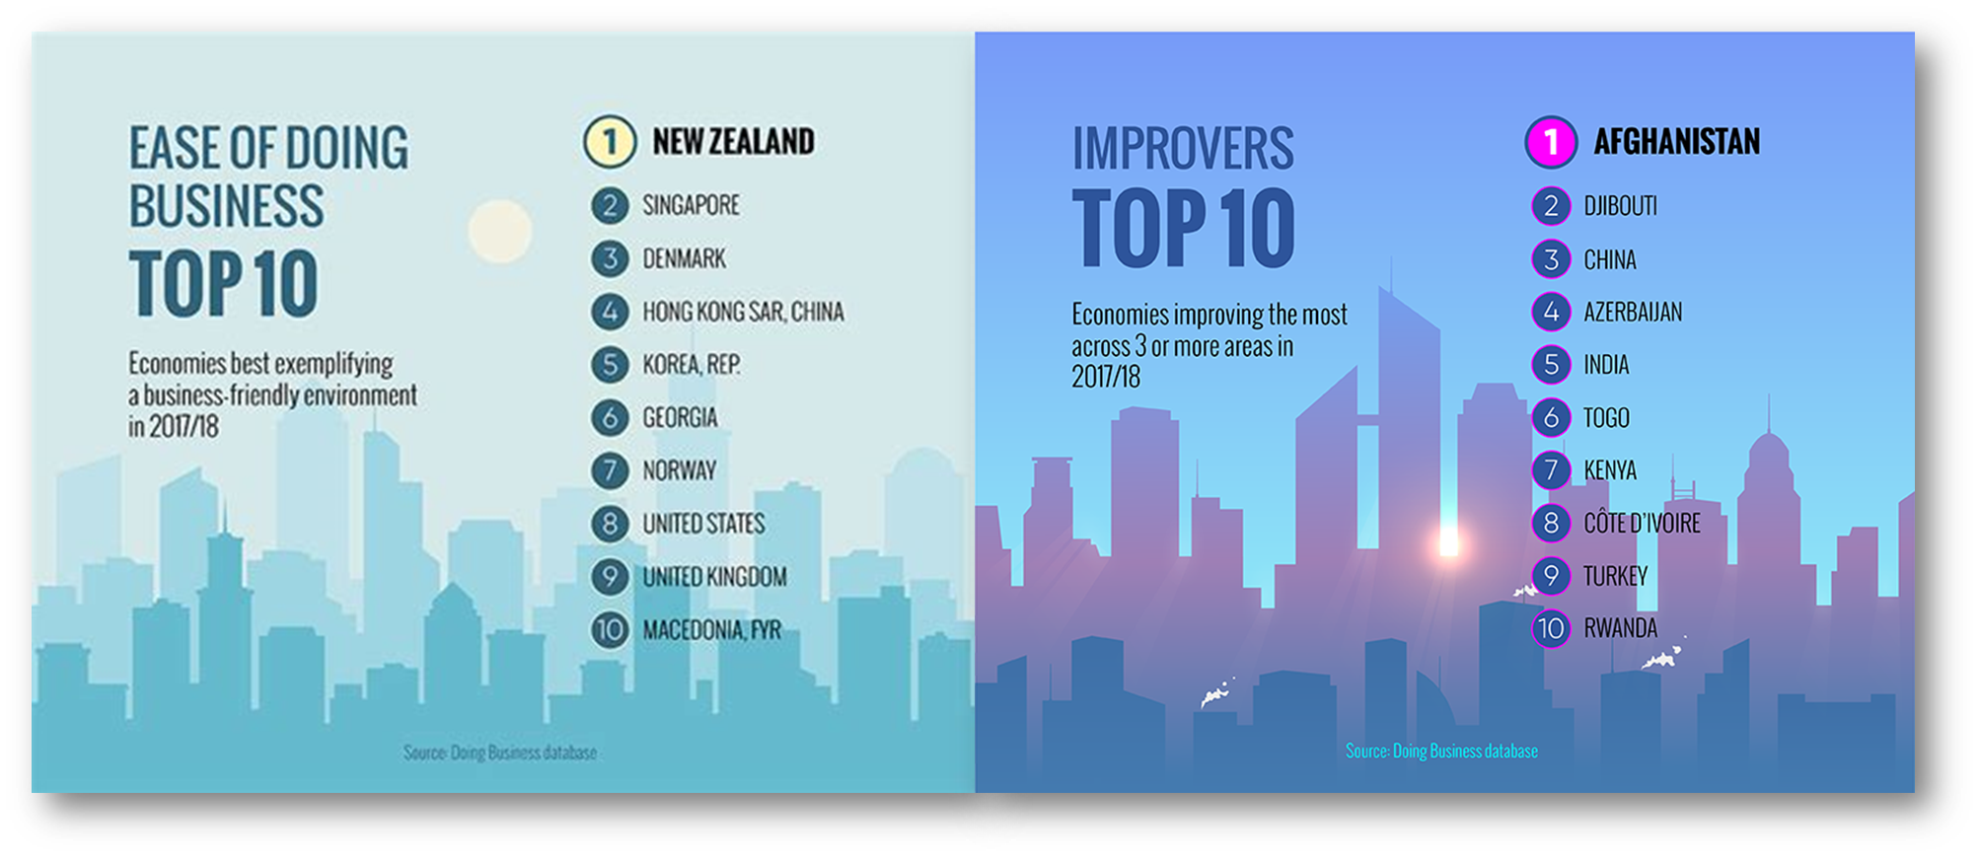

Slide 6
TOP 10 PARAMETERS
Starting a business
Dealing with construction permits
Getting electricity
Registering property
Getting credits
Protecting investors
Paying taxes
Trading across borders
Enforcing contacts
Resolving insolvency
The index is calculated as the ranking on the simple average of its percentile rankings on each of the 10 topics namely

Slide 7
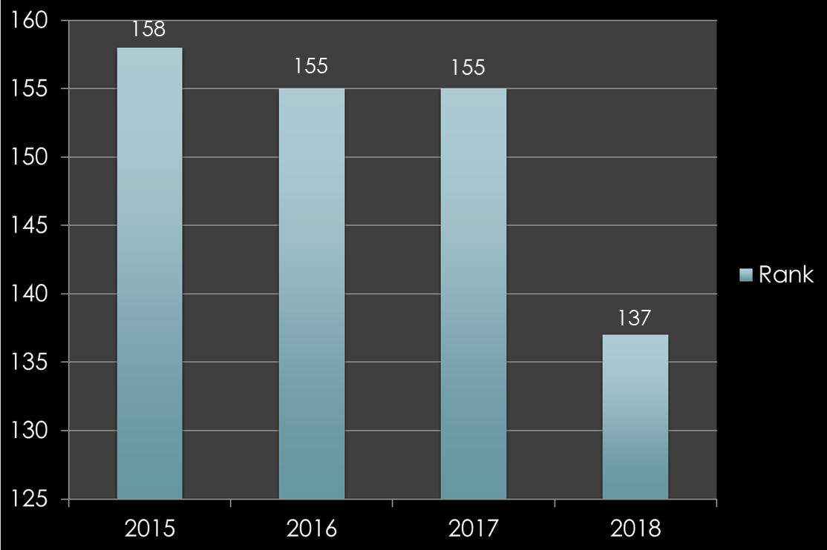

1. STARTING A BUSINESS
How easy are the procedures to start a new venture. The time , cost and minimum capital required are also considered
2018
NO. OF PROCEDURES – 10
TIME REQUIRED – 16.5 DAYS
COST(%PER CAPITA INCOME)-14.4%

Slide 8
STEPS TAKEN
The Government of India has, in collaboration with the State Governments of NCT of Delhi and Maharashtra, undertaken significant reform measures to improve our rank in Starting a Business parameter.
Registration with ESIC and EPFO has been made real-time by eliminating all physical touchpoints.
The requirement of opening a bank account has been removed as a mandatory condition for registration with ESIC and EPFO.
Provision for online payment of EPFO and ESIC contributions has been introduced.
Maharashtra has combined the process of registration with VAT and Profession Tax. The registration will now be granted in 24 hours.
The fee for filing the incorporation form has been reduced from Rs.2000/- to Rs.500.
Shram suvidha portal
Pradhanmantri rojkar protsahan yojana

Slide 9
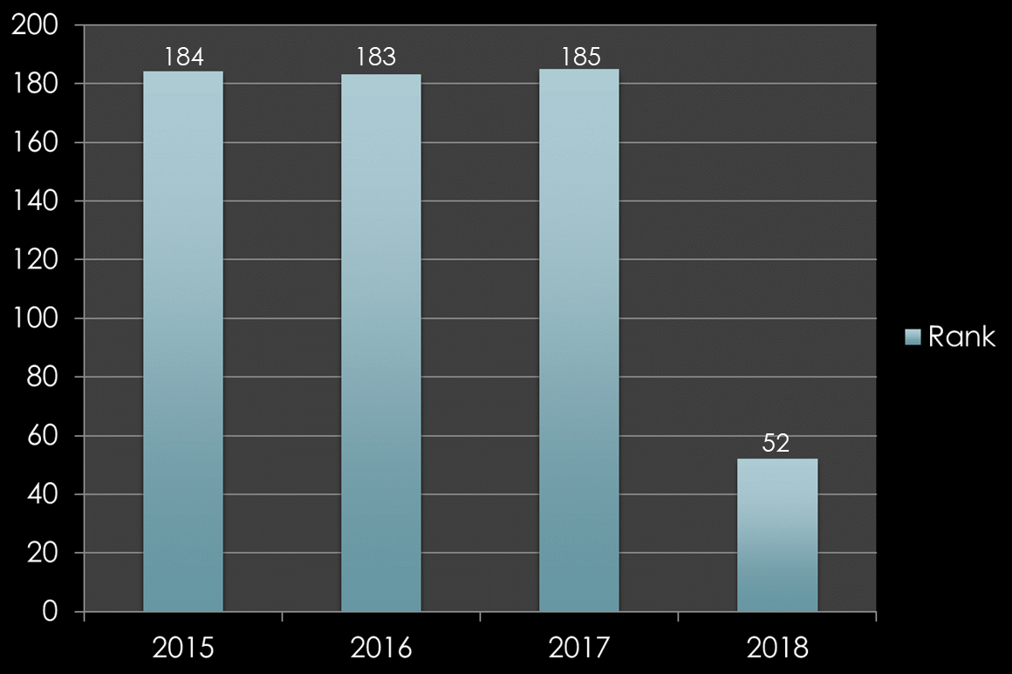
2. DEALING WITH CONSTRUCTION
PERMITS
How easy is to get permission to build a warehouse
2018
NO. OF PROCEDURES TO BUILD A
WAREHOUSE – 18
TIME REQUIRED TO BUILD A
WAREHOUSE – 94.8 DAYS

Slide 10

Both Municipal Corporation of Greater Mumbai (MCGM) and Municipal Corporation
of Delhi (MCD) have reduced the number of procedures from 42 and 29 respectively to only 8.
In Mumbai, the building completion cum occupancy certificate is issued online through the single-window.
MCD has eliminated the need for applicant to visit the Property Tax Department to collect receipt of tax payment
Delhi Development Authority (DDA) has notified the Unified Building Bye-laws. The unified building bye laws have provision of deemed approval of sanctioning building plans within 30 days.
Colour coded maps have been developed by AAI, DUAC and DMRC to enable applicants to determine whether NOC is required for the land for which permission is applied for.
88% of building plans have been sanctioned online by Municipal Corporation of Delhi.
Both MCD and MCGM has introduced digital signing of building permit application, as well as maps, thereby eliminating need of physical submission of document

Slide 11
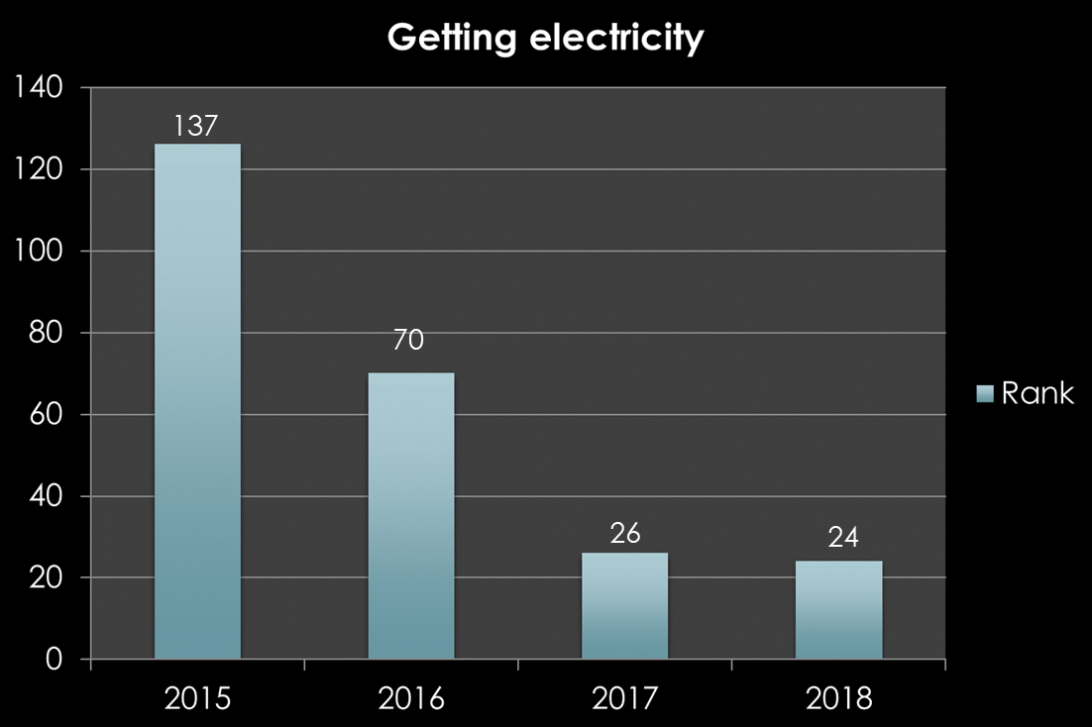

3. GETTING ELECTRICITY
The ease of obtaining a permanent electricity for a newly constructed warehouse
2018
TIME REQUIRED – 55 DAYS

Slide 12
Online application for connections above 100KVA has been made mandatory in Maharashtra
and Delhi.
Delhi Electricity Regulatory Commission (DERC) has rationalized LT and HT tariff thereby allowing LT
connections upto 150KVA.
In Delhi and Mumbai, for getting a new electricity connection the number of procedures has been
reduced to 3.
Two documents required for getting electricity connection:
1. Identity proof,
2.Proof of ownership/ occupancy of premises.
Now industrial/ commercial connections are being granted within 15 days in Delhi and Mumbai

Slide 13
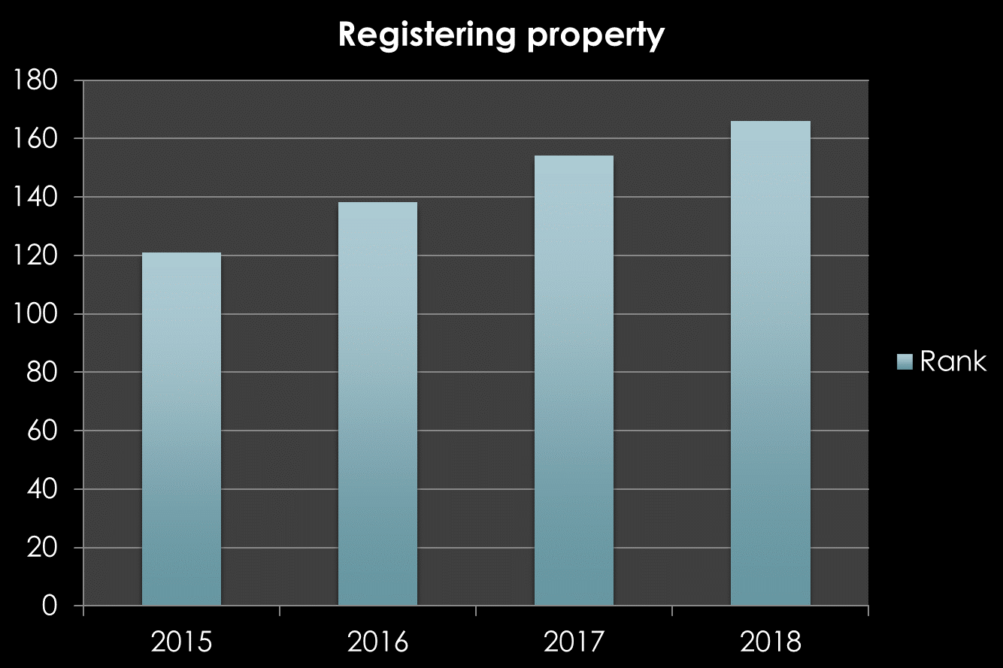



4. REGISTERING PROPERTY
How easy and uncomplicated is the process of registering commercial real estate
166
166
2008
NO. OF PROCEDURES - 9
TIME REQUIRED – 69.1 DAYS
121

Slide 14
PROBLEMS
Huge bribe associated such as for registering a land title etc
Lack of transparency which leads to land record fraud or alteration, land document forgery
and multiple allocations of the same plot of land etc.
High registration charges
Government has made registration of property online but problems in clearances continues,
they have to visit sub-registrar office concerned several times to sought out problems.

Slide 15
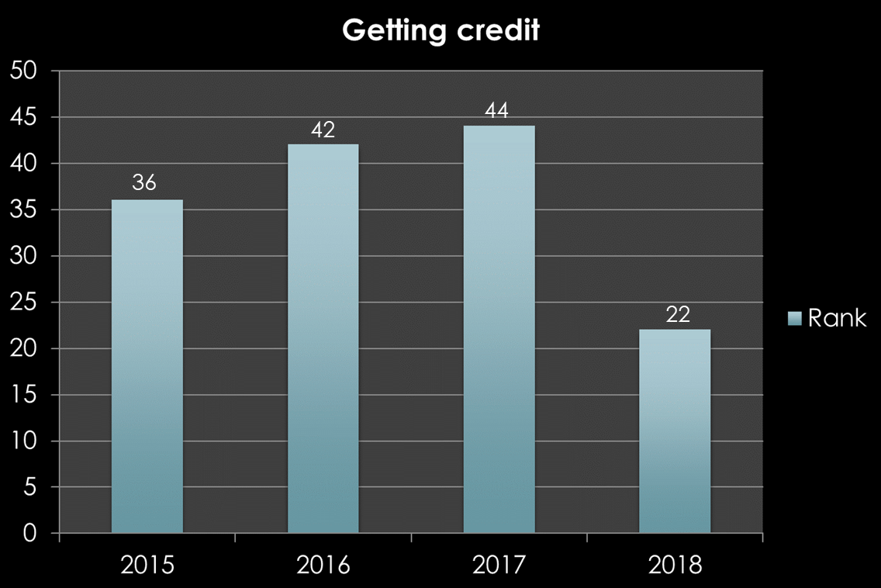
5. GETTING CREDIT
The strength of legal rights index and depth of credit information index is studied
Strength of legal rights index measures the degree to which collateral and bankruptcy laws protect the rights of borrowers and lenders and thus facilitate lending.
Depth of credit information index measures rules affecting the scope, accessibility, and quality of credit information available through public or private credit registries.

Slide 16
To ensure timely availability of funds to the MSME sector, the RBI also facilitated the setting up of electronic bill factoring exchanges in the country.
More branches were set up in the rural areas so that poor can easily access the credit scheme.
Credit availing process has been made trouble free and is easily available for the public.
Micro credit schemes are introduced in which the poor people can get credit at lowest interest rate and repay it as per the convenience.

Slide 17
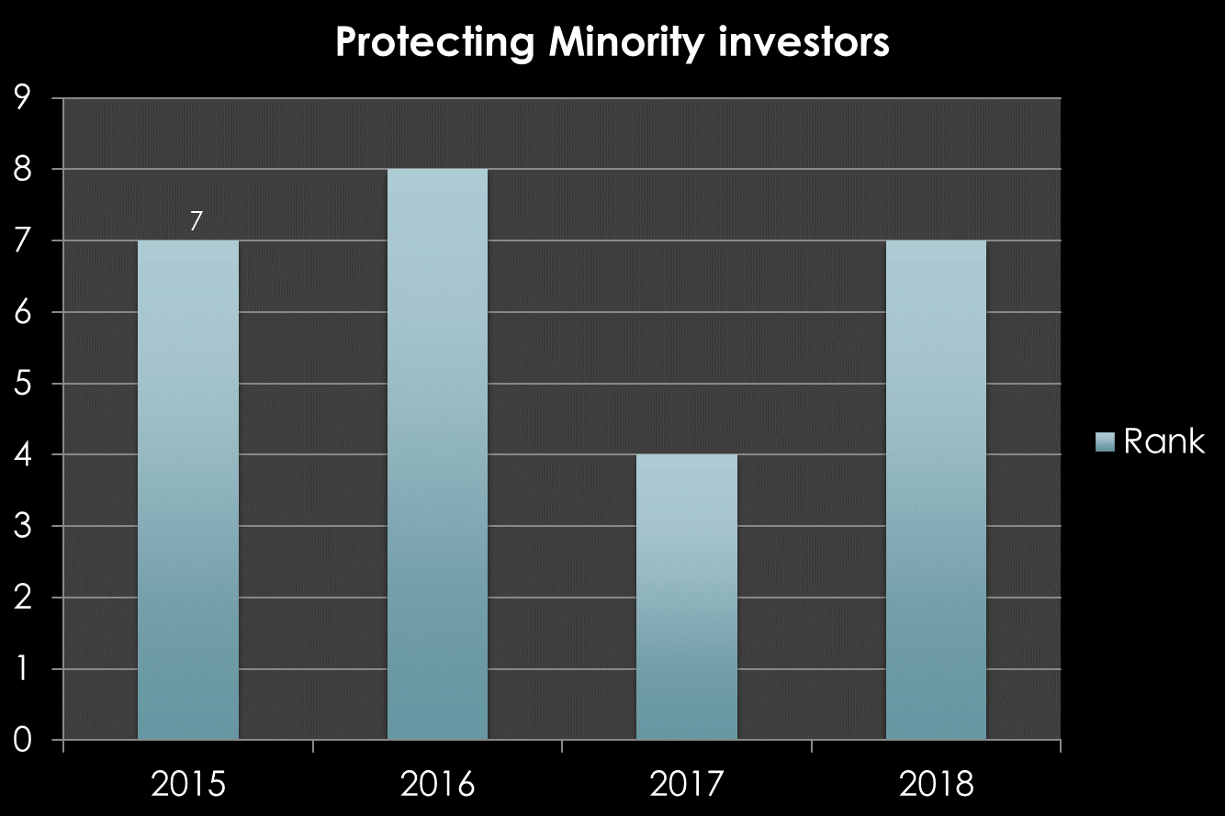

6. PROTECTING INVESTORS
Checks the various indices on the extent of disclosure and ease
of shareholding suits
13
8
7
2018
DISCLOSURE INDEX – 8
8
DISCLOSURE INDEX measures
the extent to which the
investors are protected through
disclosure of ownership and
Financial information
7
7
4

Slide 18

The security and exchange board of India(SEBI) exist to protect the interest of investors in securities
but in some cases there is pressure from financial ministry to go slow on some particular cases.
For the violation of takeover rules and fraudulent trade practices penalty is too low.
It is difficult to exactly quantify the amount of ill gotten gangs and consequently the losses
suffered by other investors.

Slide 19
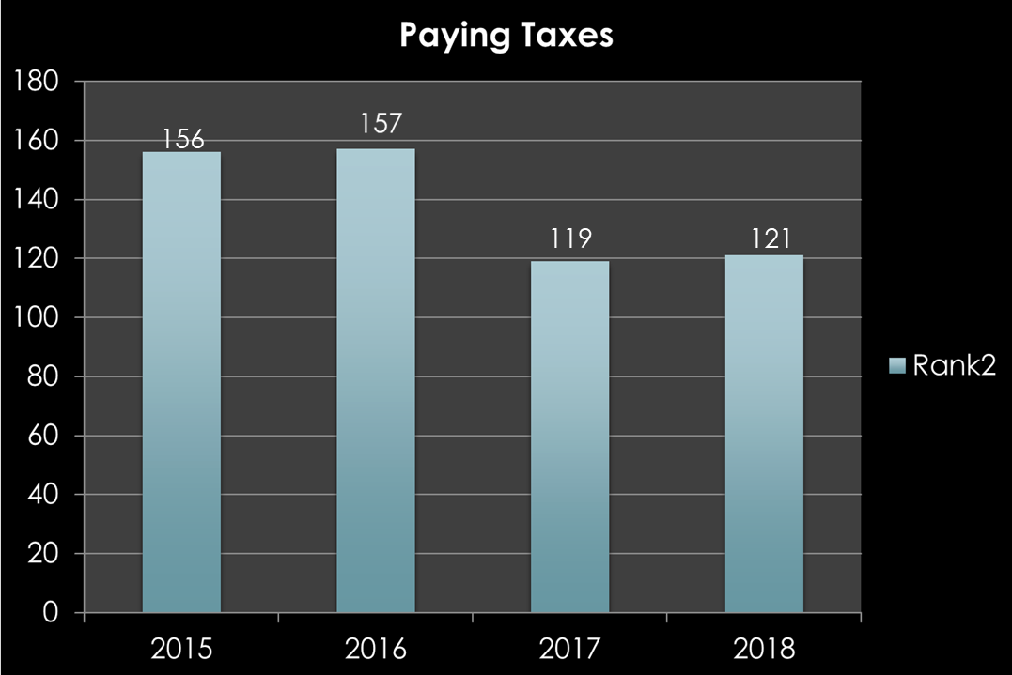
7. PAYING TAXES
Studies the number of taxes paid , hours per annum spent on filling tax returns
and total tax payable as share of gross profit

Slide 20
The rate of income tax in India was one of the highest in the world but the rev­enue is very insignificant. This is because high tax rates encouraged tax evasion and avoidance on a large scale
The biggest failure of GST implementation has been the unpreparedness of the IT backbone. It led to a lot of confusion, delays and deferments.
Experts believe that India cannot have a single rate GST, but six GST rates - 0%, 3%, 5%, 12%, 18% and 28% . This has only compounded the confusion of taxpayers many of whom are still facing problem complying with the GST.
Glitches in GST filing have led to a rise in the number of hours taken in a year to file taxes to 275.4 this year from 214 last year.

Slide 21
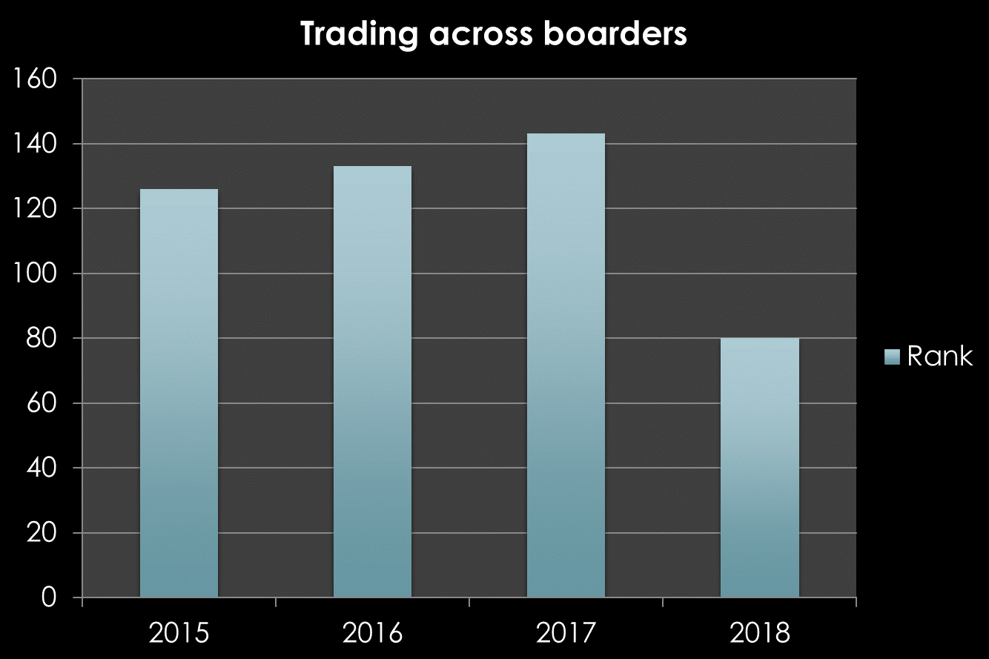
8. TRADING ACROSS BORDERS
How easy the process of exports and imports of products are in a country
143
133
126
80

Slide 22
Central Board of Excise and Customs(CBEC) has implemented Single Window Interface for Facilitating Trade (SWIFT) (online single window for clearance of goods) on the ICEGATE portal by integrating FSSAI.
An electronic messaging system between Shipping lines and custodians for electronic delivery order has been introduced.
Number of documents required for import and export has been reduced to three .
Radio Frequency Identification (RFID) tags have been installed at JNPT to monitor containers at port gates
Twenty-Foot Equivalent Unit (TEU) volume limit for direct delivery consignments has been removed.
Customs Clearance Facilitation Committee has been set up at every major customs seaport and airport at Central level

Slide 23
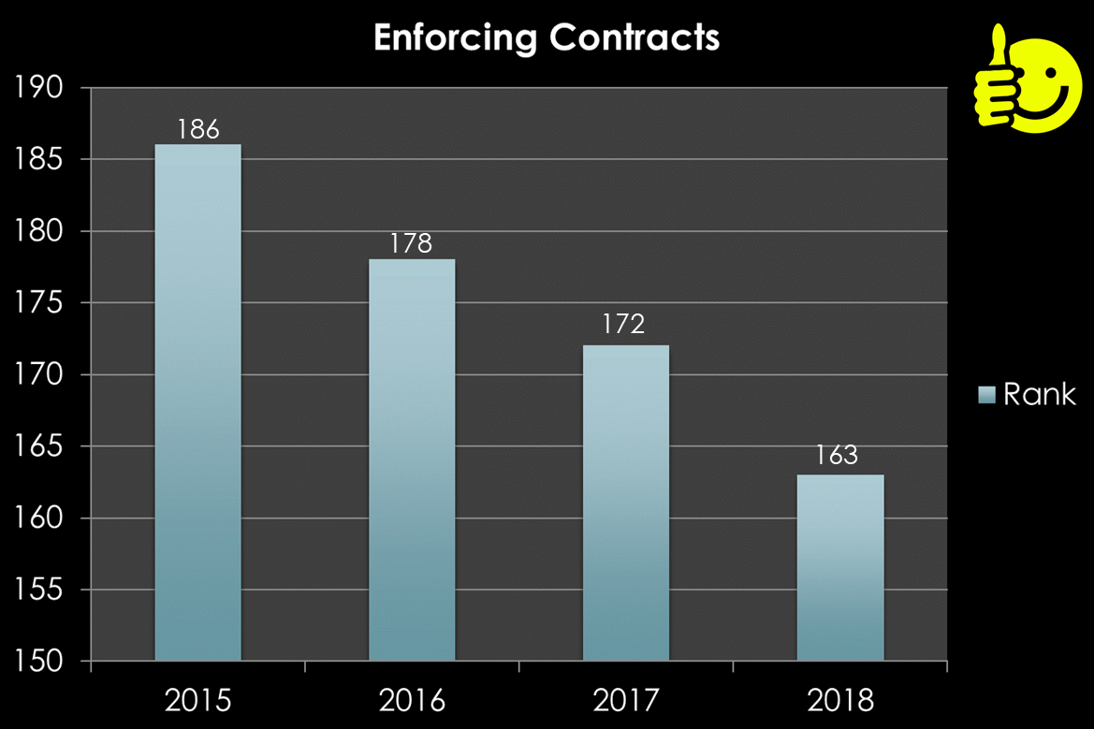
9. ENFORCING CONTRACTS
Studies the time , cost and effort required to enforce a debt contract
2018
TIME REQUIRED – 1445 DAYS

Slide 24
In 2017, India’s rank improved by 6 points in this indicator from 178th to 172nd.
National Judicial Data Grid (NJDG) was opened to general public on 19th September, 2015. NJDG is a national data warehouse for case data including case registration, cause list, case status and orders/judgments of courts across the country till District Level Courts.
The Arbitration and Conciliation Act has been amended to reduce the time taken in arbitration proceedings and grounds on which an award may be challenged.
Commercial Appellate Division Bench and Commercial Division Benches are functioning in Bombay High Court and Delhi High Court. These dedicated commercial benches will help faster disposal of commercial cases in Delhi and Mumbai.

Slide 25
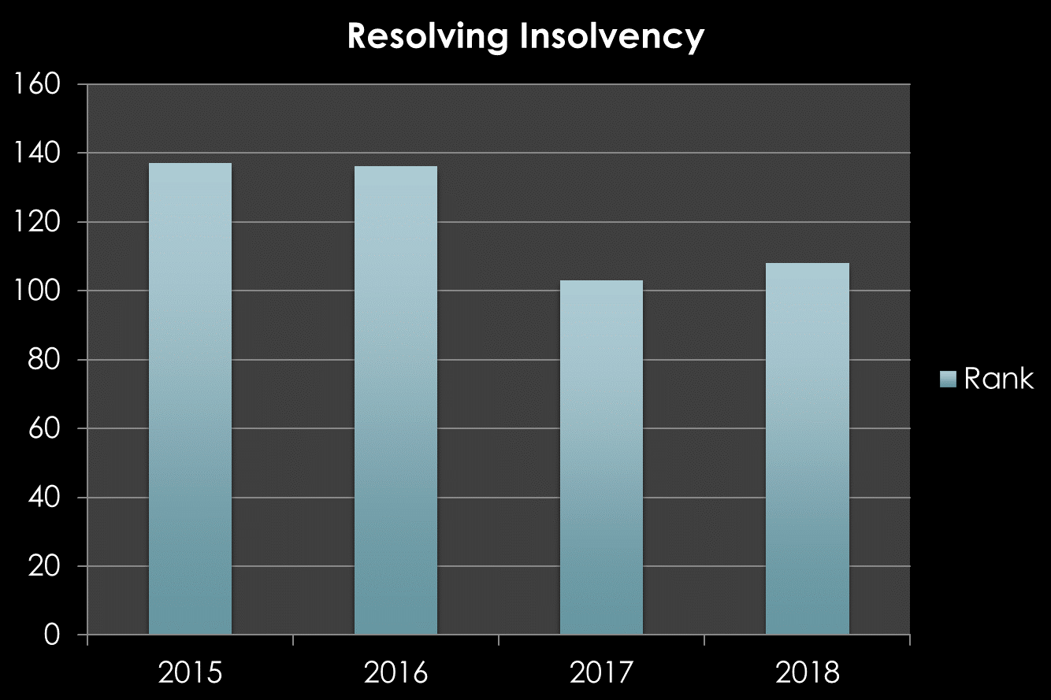
10. RESOLVING INSOLVENCY
Checks the time , cost and percentage recovery rate under bankruptcy proceeding
16
137
136
2018
Time required – 4.3 years
103
108

Slide 26

Insolvency and Bankruptcy Code of 2016, a framework for dealing with situations where an individual or a company is unable to repay their outstanding debt.
“If an IBC application has been admitted by the NCLT, proceedings under other laws will be stayed until the IBC-led insolvency resolution is completed: This can last up to a maximum of 270 days” says Suharsh Sinha of AZB & Partners.
Lack of Directors Liability in areas such as Paying back profits and damages to shareholders in case of willful Fraud

Slide 27
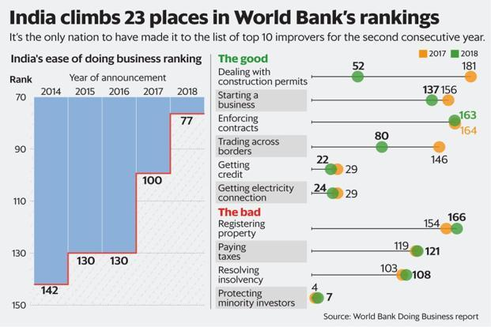

Slide 28
LIMITATIONS
The collected data refer to business in the economy’s largest business city and may not be representative of regulation in other parts of the economy . To address this limitation, sub national Doing Business indicators were created
The data often focus on a specific business form—generally a limited liability company of a specified size—and may not be representative of the regulation on other businesses.
Transactions described in a standardized case scenario refer to a specific set of issues and may not represent the full set of issues a business encounters.
In order to standardize data across countries, it makes several assumptions, some of them quite ridiculous.

Slide 29
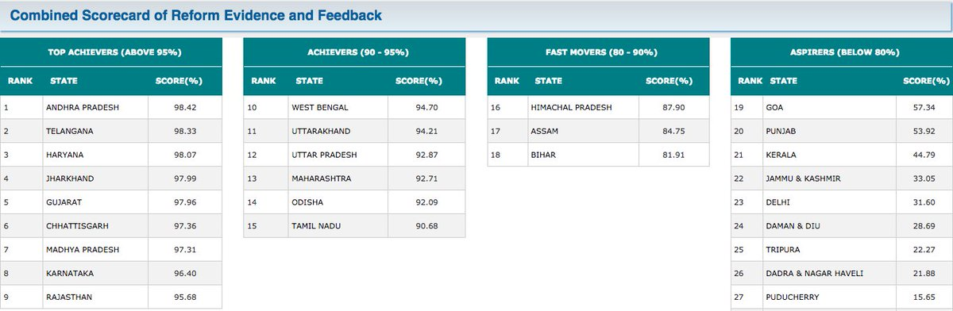

Slide 30
GUJARAT has introduced an investor support system, web labour portal, tax services online etc. Single window clearances have been stressed upon, and the policy for the same aims to provide all major permissions in 21 working days, which is still long. Land records have also been digitalized
Maharashtra ensured that registration under the Building and Other Construction Workers act is provided online via a single window system. It facilitates online application submission, payments, tracking status, approvals and issuance of certificates.
Mumbai had reduced the number of permissions required for constructing a building to 8 from 42. The time taken to get clearances was also cut to 60 days from 160 ,also permissions for electricity connections were now given online and connections were provided within 9 days.

Slide 31
MAJOR INITIATIVE TAKEN BY
INDIAN GOVERNMENT
MAKE IN INDIA , a type of swadeshi movement covering 25 sectors of economy .was launched by the government of India on 25 September 2014 to encourage companies to manufacture their products in India and enthuse with dedicating investment Into manufacturing. As a strategy it is road map to respond to global challenges through preparations for a world class manufacturing status and knowledge infrastructure that should create further knowledge for stepping on to global competitiveness .under this scheme Startup India , pentagonal industrial corridors and E-biz portal etc are covered.
START UP INDIA campaign is based on an action plan aimed at promoting bank financing for start-up ventures to boost entrepreneurship and encourage start ups with jobs creation.
It is focused on to restrict role of States in policy domain and to get rid of "license raj" and hindrances like in land permissions, foreign investment proposal, environmental clearances. It was organized by Department of Industrial Policy and Promotion (DIPP).
The government has already launched PMMY, the MUDRA Bank, a new institution set up for development and refinancing activities relating to micro units.
STAND UP INDIA initiative is also aimed at promoting entrepreneurship among SCs/STs, women
communities
SIMILARILY - SETU Fund ,MUDRA Bank ,Atal Innovation Mission (AIM) etc also introduced.

Slide 32
NSW FOR TRADE FACILITATION
Malaysia’s eBased Trade Eco-system
In Malaysia, the backbone of electronic-based trade eco-system is the National Single Window (NSW) for Trade Facilitation - a one-stop Trade Facilitation system linking the trading community with relevant Government agencies and various other trade and logistics parties through one single window, which allows for a seamless and transparent process.
Malaysia’s NSW was launched in 2009 to simplify clearance procedures, facilitate the electronic exchange of trade-related data, reduce cost of doing business.
In Malaysia, the NSW for Trade Facilitation system is developed, operated and managed by Dagang Net Technologies Sdn Bhd (Dagang Net).

Slide 33
Fast Facts on Malaysia’s NSW for Trade Facilitation
Connects more than 25,000 users
Processes more than 100 million electronic transactions annually
Connected with more than 30 Permit Issuing Agencies, 50 authorities, 10 banks, 160 Customs stations
Comprises 6 core eServices and they are ePCO, ePermit, eDeclare and ePayment etc.
More accurate and increased collection of customs duty payments which has risen to RM 1.8 billion annually.
Better compliance by trade communities as seen in the huge increase from 40 million electronic document transfers in 2003 to 275 million in 2009.

Slide 34
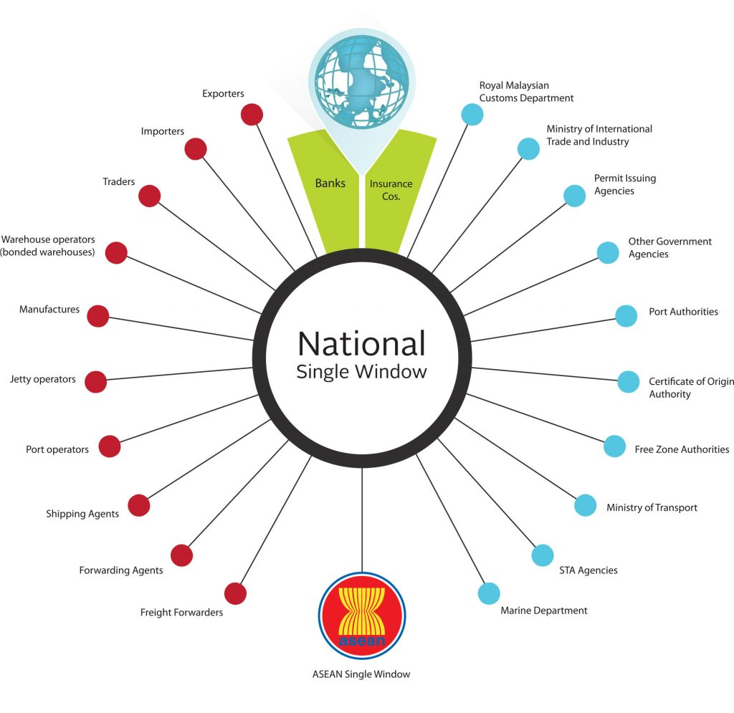
BENEFITS
To the clients: -
Reusability of data
Data accuracy
Time saving & cost reduction Enhance efficiency
To the participating agencies
Encouraged the usage of electronic application/submission
Efficiency (less data entry and service counter)
Time saving and cost reduction
In line with the government direction to go electronic

Slide 35
CONCLUSION
DIGITALISATION SHOULD BE ENCOURAGED
NATIONAL SINGLE WINDOW SHOULD BE ADOPTED
EDUCATION SYSTEM FACILITIES SHOULD BE INCREASED
STARTUPS SHOULD BE ENCOURAGED

Slide 36
BIBLIOGRAPHY
www.doingbusiness.com
///C:/Users/SALONI%20GOYAL/Downloads/easeofdoingbusiness-12018001434-phpapp02.pdf
https://www.unece.org/fileadmin/DAM/cefact/single_window/draft_160905.pdf
www.financialexpress.com
www.worldbank.org
www.indiatoday.com
www.makeinindia.com
www.wdi.worldbank.org
www.ictbm.org
https://www.unece.org/fileadmin/DAM/cefact/single_window/draft_160905.pdf

Slide 37

THANK YOU!
BY-
SALONI GOYAL
PRIYANSHI AJMERA

